Slide 1
CS3300 – Introduction to Software Engineering
John Doe Portfolio
March 5th, 2025
Department of Computer Science
University of Colorado, Colorado Springs
Spring 2025

Slide 2
Team Members and Roles:
Jack Dodge – Developer, Tester, Product Owner
West Manison – Developer, Tester, Test Coordinator
George morales – Developer, Tester, Lead-Tech Writer
Sebastian Sanchez – Developer, Tester, UI/UX Lead
Date
Name

Slide 3
Project Introduction:
John Doe Portfolio
We developed a visually appealing and responsive portfolio website that effectively showcased John Doe's projects, experience, and skills. The website featured a dynamic home page and four distinct project pages, allowing users to navigate seamlessly and access detailed information about each project. Our goal was to create an engaging user experience that highlighted John Doe’s expertise and professional achievements.
05 March 2025
Jack Dodge

Slide 4
Problem Statement:
How does someone stand out in a competitive and evolving job market?
Our answer: differentiation. A portfolio website dedicated to a job-seeker’s projects, CV, and other important information allow a job-seeker to stand out. A portfolio is a demonstrable product that allows for hiring-managers and others who may be interested, to quickly identify skills, interests, and experience.
05 March 2025
George Morales

Slide 5
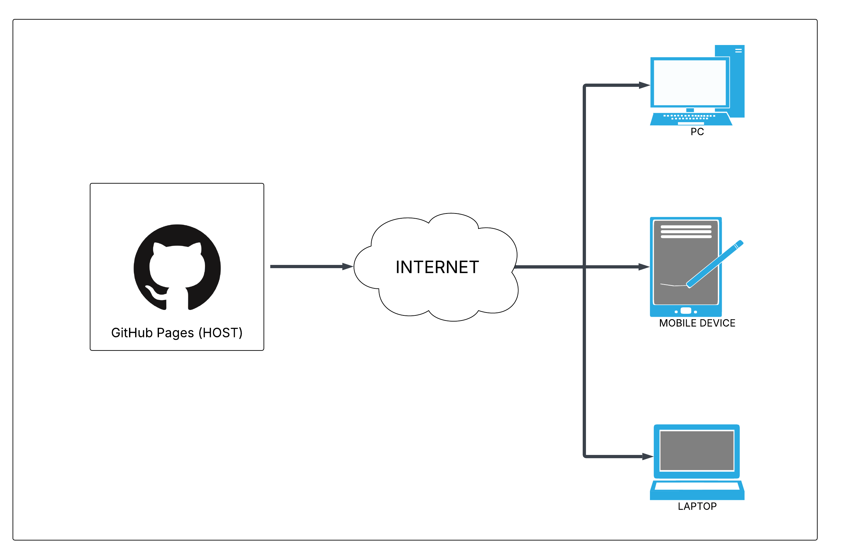
Architecture Diagram
The architecture diagram for our project is fairly straightforward since GitHub Pages is a static site host.
Date
Name

Slide 6
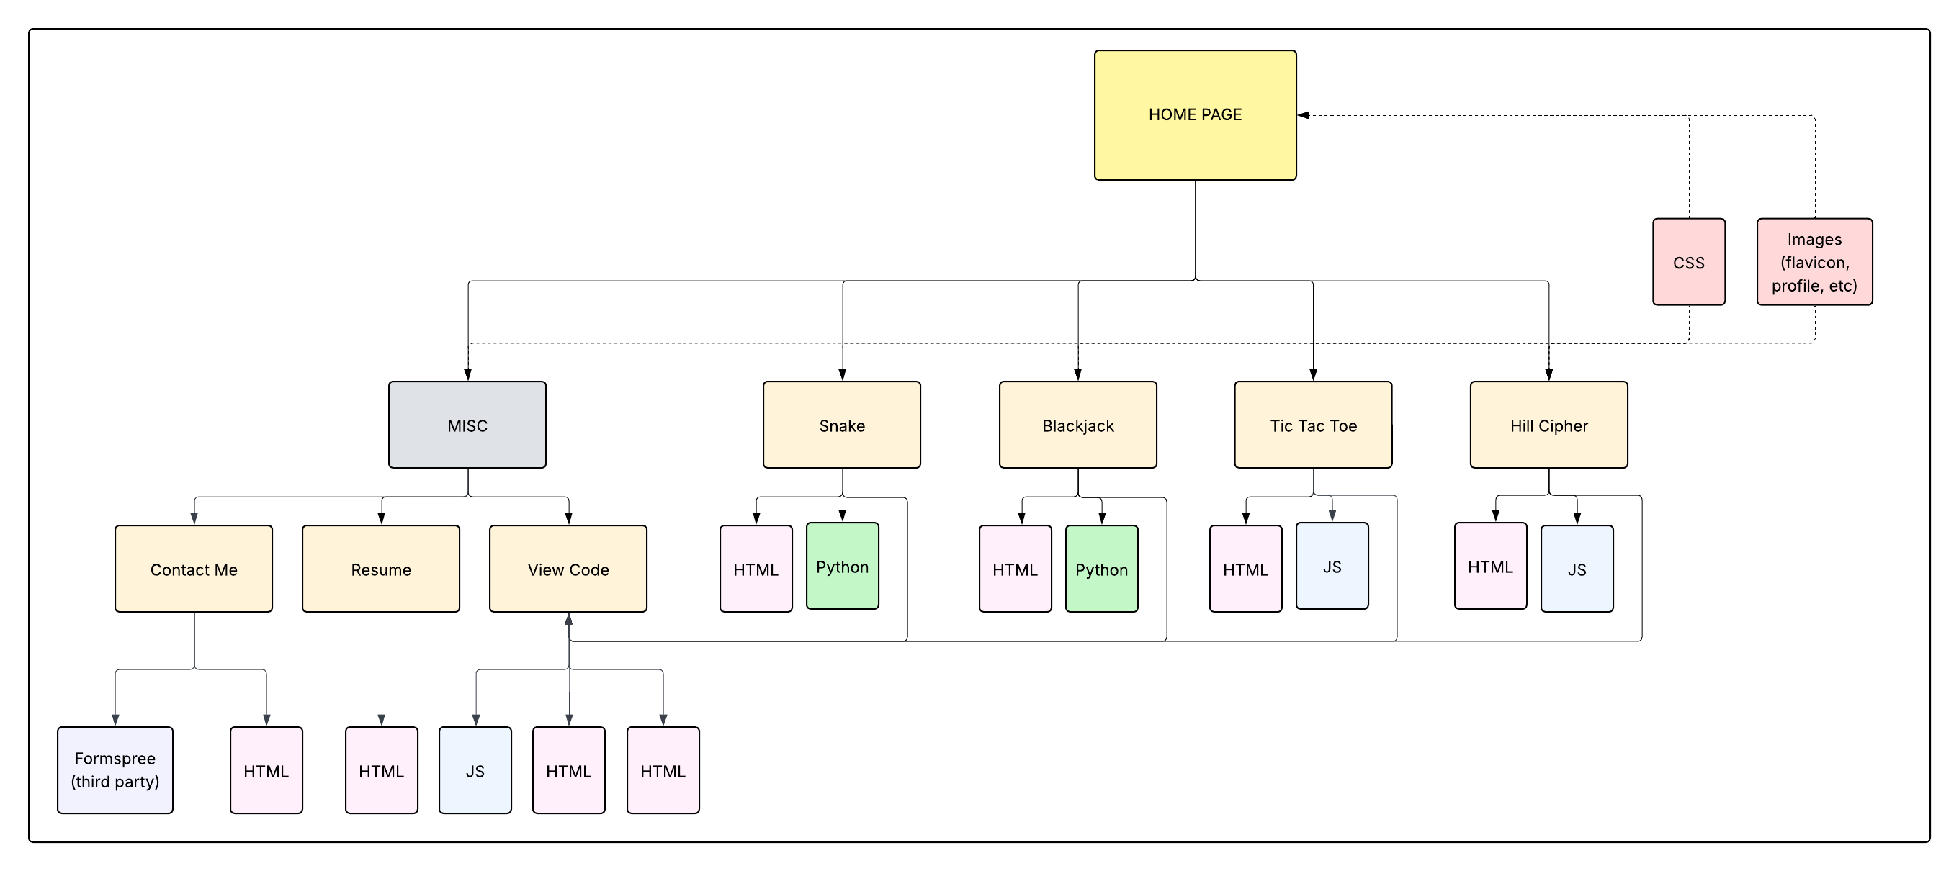
Software Design Diagram
Date
Name

Slide 7
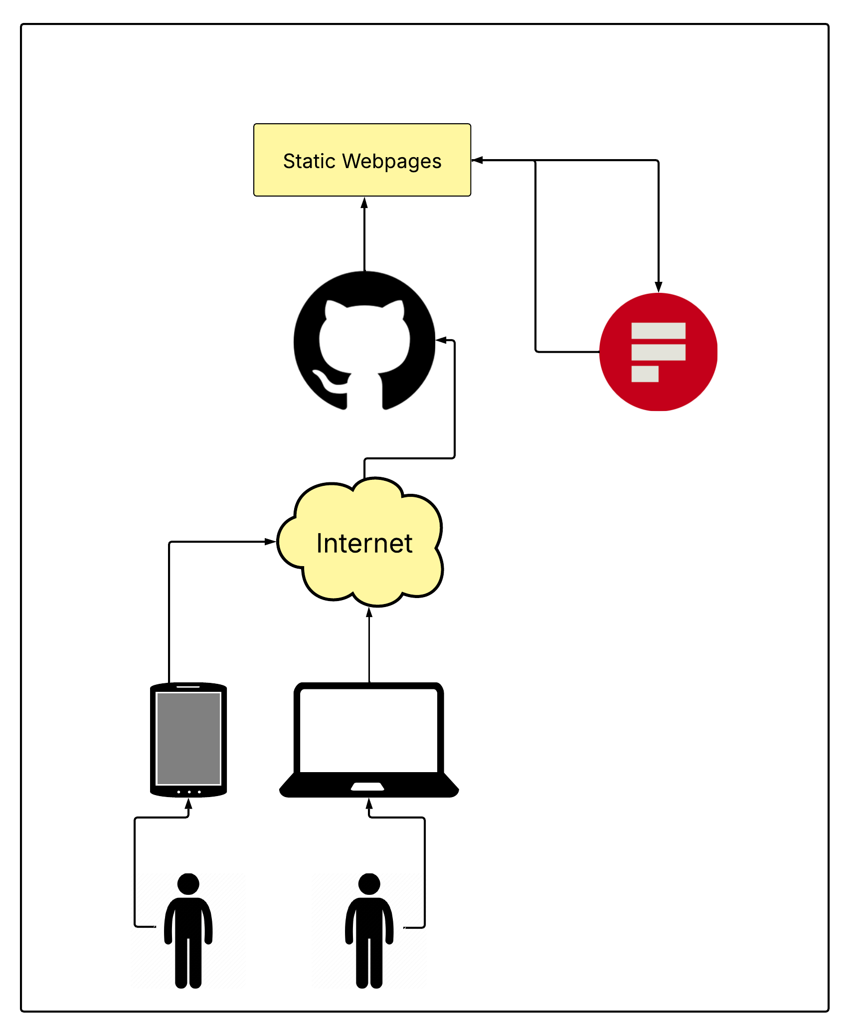

Perspective User Model
User’s access internet from personal device and can then access GitHub’s webhosting service.
User interacts with a host of static pages, one of which redirects to a third party (for the contact me page) and then returns to the static pages hosted by GitHub
Date
Name

Slide 8
Configuration Management
Version Control: GitHub​
Dependencies: Front-End Libraries/Frameworks, GitHub Pages (static pages only)​
Testing: Manual Testing​
Deployment: GitHub Pages, DNS Provider, Thid Party Form Service.
Documentation: README.md, Code Comments, Project Wiki (GitHub)​
Licensing: MIT License
Date
Name

Slide 9
Testing (V&V)
Test Driven Development [TDD]
Manual testing was led by each team member for their own assigned subproject.
<NEED IMAGE>
Date
Name

Slide 10
Known Bugs
Even with extensive coding, we finished our project with a couple of known bugs:
Tic Tac Toe game doesn’t end after a winner is decided.
Snake and Blackjack games have issues with being embedded on a site hosted by GitHub Pages
Hill Cipher program can encrypt messages but is unable to decrypt them.
Date
Name

Slide 11
Metrics
Date
Name

Slide 12



Software Engineering Tools
Web Development
Visual Studio Code (IDE)
HTML5 ( Hypertext Markup Language 5)
CSS ( Cascading Style sheet –Version 4.15- )
JavaScript – ECMAScript 2023
Python
Git/GitHub
GitHub Pages (Host)
Version Control
Third Party
Go Daddy (DNS Provider)
FormSpree (Contact Me)
Testing [TBD]
Manual
Date
Name

Slide 13
Ethics Observation(s):
Date
Name

Slide 14



Software Engineering Principles:
Judgment:
As software engineers, we maintained a level of integrity and independence within our professional judgment. We prioritized website accessibility, making thoughtful design and content decisions throughout the development process.
Public:
We acted in the interest of the public by offering a level of transparency regarding link redirection and source code availability.
Management:
We upheld an ethical approach to the management of software development and maintenance, encouraging responsible decision-making and accountability throughout the development and upkeep of the website.
07 May 2025
Presenter

Slide 15
Project Risk Management
RISK​ | Prob.​ | Impact​ | Mitigation ​
Scheduling Conflicts (Person)​ | High​ | Medium-Low​ | Ensuring open communication. When we cannot meet in person, making sure that we’re using alternative communication (Discord, text, etc.).​
Scope Creep (Project)​ | Medium​ | High​ | Stay true to the Requirements Spreadsheet and don’t work outside of necessary constraints before there is available time.​
Programmer is unable to finish requirements by the corresponding due dates (Person)​ | Medium​ | Medium​ | Other programmers can come in to assist in the completion of the requirements to keep the schedule intact.​
Date
Name

Slide 16
Date
Name

Slide 17
Project Completion
Functional Portfolio Website:
The main page and all sub-projects are fully developed. Integration testing and refactoring is required.
Testing is Complete:​
Most unit, integration, and user tests were successfully passed.​
Documentation is Finalized:​
The project includes a complete and up-to-date README file outlining setup, purpose, and usage. Additional documentation supports maintainability and future updates.
Deployment is Successful:​
The website is live on GitHub Pages.
Date
Name

Slide 18
Demonstration?

